Slide 1


Welcome to Convocation 2023

Slide 2

Journey to the Future of Catechesis
Designed to envision new directions and initiatives for proclaiming and teaching the Catholic faith in our world today guided by the vision and practices of the Directory for Catechesis.
How can the vision and practices of the Directory for Catechesis guide catechetical ministry in parishes across the United States and transform catechesis with all ages and generations in a parish community.

Slide 3
From Vision to Practice
Whole Community / Intergenerational
Families
Children
Adolescents
Young Adults (20s-30s)
Midlife Adults (40s-50s)
Mature Adults (60s-70s)
Older Adults (80+)
@ Home
@ Parish
@ School
@ Community / World

Slide 4
The Program
Day One
1:00 pm Opening Activity: Our Calling and Vocation
2:30 pm Session 1. Exploring the Vision & Practices in the
Directory for Catechesis
Session 2. Identifying the Challenges We Face
        Session 3. Designing Catechesis for Families & All Ages
5:15pm Break for Dinner
6:30 pm Session 3. Designing Catechesis (continued)
8:30 pm Close

Slide 5
The Program
Day Two
8:30 am Morning Prayer
9:00 am Session 3. Designing Catechesis (continued)
      Session 4. Designing Catechist Formation
12 noon Lunch
1:00 pm Session 4. Designing Catechist Formation (continued)
4:00 pm Depart

Slide 6

Storytelling Experience
The Calling & Vocation of Catechists
Image your life as a catechetical leader like the
chapters of a book that is still being written.

Slide 7
Storytelling Experience
The Calling & Vocation of Catechists
Image your life as a catechetical leader like the chapters of a book that is still being written.
Use Chapter 1 to describe your call to catechetical ministry:
How did you experience God calling you to catechetical ministry?
Who was involved?
What were the circumstances?
What was it like for you?
Use the following Chapters to describe your calling over time:
How has your calling and ministry evolved and changed over time.
What are the major chapters of your life as a catechetical leader.
Develop titles for each chapter, reflecting your journey in catechetical ministry.
Describe your experiences and roles in each chapter of your life in catechetical ministry.

Slide 8
Part 1. Exploring the Vision of the Directory for Catechesis
Introduction: Evolution of Catechetical Directories
Presentation: Features of the Directory for Catechesis that lead to a new or renewed catechetical practice
  Resource Team Reflections
  Review: Features of the Directory that lead to pastoral application
Application: Applying the Directory to Parish Life – Assessment Tool
Discussion: How can the Directory for Catechesis inform and guide parish catechetical practice now and into the future? Identify 5-6 ways.

Slide 9
Evolution of the Catechetical Directories
International Study Weeks
Six International Catechetical Study Weeks were held spanning the years from 1959 to 1968. The participants were pastoral theologians who were interested in kerygmatic church renewal, liturgical renewal, catechetics, and missions.
They examined the relationship between catechesis and liturgy.
They affirmed the kerygmatic approach and outlined principles for the renewal of catechesis.

Slide 10
Evolution of the Catechetical Directories
International Study Weeks
They introduced the idea of “pre-evangelization” and talked of “preparing the ground” and “using a language with which [people] are familiar.”
They used concepts such as conversion, evangelization, faith, salvation history, adaptation and the “anthropological” approach.
The final study week, held in Medellin in 1968, passed a formal resolution asking that its conclusions be incorporated into the GCD, specifically Medellin emphasized the need for a pluralistic approach to catechesis. Medellin speaks of pluralism (diversity of cultures) as a sign of life and energy.

Slide 11
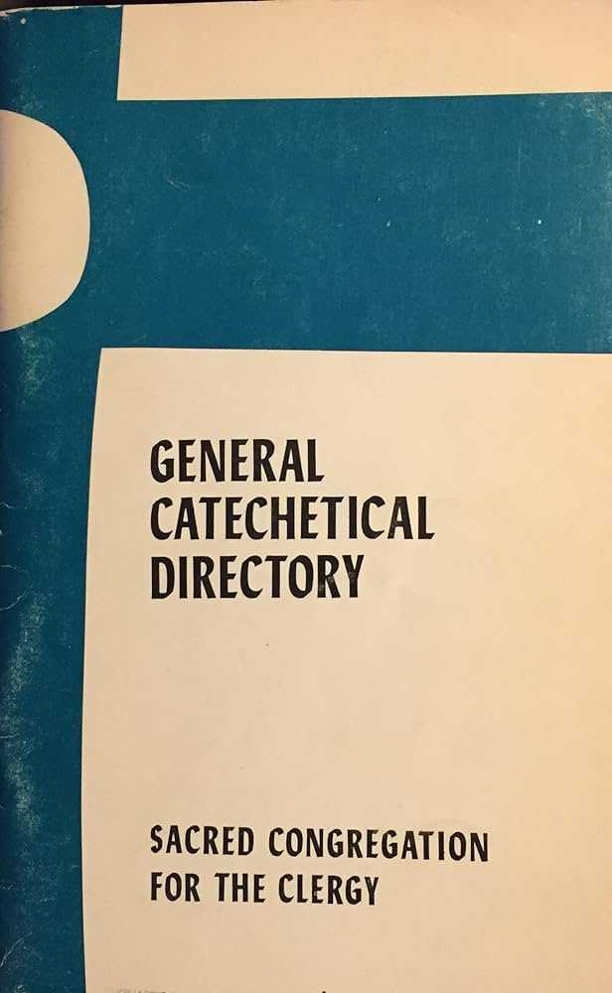
Evolution of the Catechetical Directories
General Catechetical Directory
(1971)
Vatican II’s decision to create a directory, as well as the GCD itself, affirmed the vision of catechesis that evolved during the modern catechetical movement.

Slide 12
Evolution of the Catechetical Directories
General Catechetical Directory (1971)
“Catechesis is . . . that form of ecclesial action which leads both community and individual members of the faithful into maturity of faith (#21). This implied the lifelong nature of catechesis in its relation to faith and the continuous process of conversion which is “always present in the dynamics of faith. Catechesis is one means of deepening that faith conversion” (#18, 22).
Catechesis is one form of the Ministry of the Word, along with evangelization (or missionary preaching), worship, and theology.

Slide 13
Evolution of the Catechetical Directories
General Catechetical Directory (1971)
Emphasis on catechesis as a lifelong activity. Adult catechesis is the model and norm. Catechesis had come to be seen as something for all ages, not just children.
The primary arena for catechesis was seen as the community rather than the classroom.
The people who hand on faith came to be regarded more highly than catechisms, though catechisms still had a place within catechesis.
Catechesis could be systematic or occasional, for individuals or communities, organized or spontaneous.

Slide 14

Evolution of the Catechetical Directories
General Directory for Catechesis (1997)

Slide 15
Important Characteristics
Discipleship & Continuing Conversion
A Church of Living Signs
6 Tasks:
Knowledge, Liturgy, Moral, Prayer, Community, Missionary Spirit
Catechumenate as a Model of Catechizing Activity
Church of the Home as a Unique Locus for Catechesis
Inculturation of the Gospel Message
The Church as a Source, Locus, and Means of Salvation

Slide 16
Evolution of the Catechetical Directories
General Directory for Catechesis (1997)
1. Discipleship and Continuing Conversion
  “. . . encourage a living, explicit and fruitful profession of faith” (66) and to “put people not only in touch, but also in communion and intimacy, with Jesus Christ” (80).
2. A Church of Living Signs
  The local church is the sacrament of the encounter with the living Spirit of Jesus, the Christian reality at its most primary level. The agent of catechesis is “the Church animated by the Holy Spirit” (77). Catechesis is an essentially ecclesial act, and when the local corporate body of believers is in fact the Church animated by the Holy Spirit, it becomes the main “agent” of catechesis proclaiming the Gospel (78). The Christian community is in herself living catechesis. . . (141).

Slide 17
Evolution of the Catechetical Directories
General Directory for Catechesis (1997)
3. The Church as Source, Locus, and Means of Catechesis
  Catechetical pedagogy will be effective to the extent that the Christian community becomes a point of concrete reference for the faith journey of individuals. This happens when the community is proposed as a source, locus, and means of catechesis. Concretely, the community becomes a visible place of faith-witness. It provides for the formation of its members. It receives them as the family of God. It constitutes itself as the living and permanent environment for growth in faith. (158)
  Catechesis is nothing other than the process of transmitting the Gospel, as the Christian community has received it, understands it, celebrates it, lives it, and communicates it in many ways” (105).

Slide 18
Evolution of the Catechetical Directories
General Directory for Catechesis (1997)
4. Six Fundamental Tasks of Catechesis
  knowledge of the faith
  knowledge of the meaning of Liturgy and the sacraments
  moral formation in Jesus Christ
  teaching how to pray with Christ
  preparing to live in community and participate actively in the life and mission of the Church
  a missionary spirit that prepares the faithful to be present as Christians in society” (85-87).

Slide 19
Evolution of the Catechetical Directories
General Directory for Catechesis (1997)
These tasks of catechesis constitute a totality, rich and varied in aspect.
All of these tasks are necessary.
Each task realizes, in its own way, the object of catechesis.
They are interdependent and develop together.
To fulfill its tasks, catechesis avails of two principle means: transmission of the Gospel message and experience of the Christian life.
The different dimensions of faith are objects of formation as much of being given as received.
Every dimension of the faith, like the faith itself as a whole, must be rooted in human experience and not remain a mere adjunct to the human person.

Slide 20
Evolution of the Catechetical Directories
General Directory for Catechesis (1997)
5. Catechumenate as a Model of Catechizing Activity
An integrated catechesis incorporating:
formation through participation in the life of the faith community
education in Scripture and the Catholic tradition
apprenticeship in the Christian life
intimate connection with the liturgy and rituals of the Church
development of a life of prayer
engagement in actions of justice and service. (90)

Slide 21
Evolution of the Catechetical Directories
General Directory for Catechesis (1997)
6. The “Church of the Home” as a Unique Locus for Catechesis
The family is the “church of the home” or “domestic church” and a unique locus for catechesis. “ . . . in every Christian family the different aspects and functions of the life of the entire Church may be reflected: mission; catechesis; witness; prayer etc. Indeed in the same way as the Church, the family is a place in which the Gospel is transmitted and from which it extends. The family as a locus of catechesis has a unique privilege: transmitting the Gospel by rooting it in the context of profound human values. It is, indeed, a Christian education more witnessed to than taught, more occasional than systematic, more ongoing and daily that structured into periods. (255)

Slide 22
Evolution of the Catechetical Directories
General Directory for Catechesis (1997)
7. Inculturation of the Gospel Message
Catechesis inculturates the Gospel message so that it is proclaimed and taught in the language and culture of the people. A catechesis of inculturation means presenting the teaching of the faith in a complete and authentic way in dialogue with the language, customs, and practices of those to whom the Gospel is presented. (See GDC 109-113, 203)

Slide 23
Evolution of the Catechetical Directories
Directory for Catechesis
(2020)

Slide 24
Important Characteristics
Accompaniment
Education
Formation
Communion
& Intimacy
Catechumenal Model
5 Tasks:
Knowledge, Liturgy, Moral, Prayer, Community
7 Sources:
Scripture & Tradition, Magisterium, Liturgy, Saints, Theology, Christian Culture, Beauty
Variety of Educational Processes & Methods
Human Experience Integral to Catechesis
Catechesis & Culture
Digital Culture
Kerygma
Family
Lifelong Catechesis

Slide 25
Applying the Directory for Catechesis to Parish Life
Assessment
This assessment tool explores how the Directory of Catechesis informs the vision and practice of catechesis with all ages and generations in your parish community. For each characteristic from the Directory indicate how true that characteristic is in the actual practice of catechetical ministry in your parish community: 1=strongly disagree, 2=disagree, 3=neither agree nor disagree, 4=agree, and 5=strongly agree.
Reflection
How well does our catechetical ministry embrace and apply the vision of catechesis in these ten characteristics from the Directory for Catechesis?
What are the areas of strength in your community?
What are the areas for improvement or enhancement in your community?
What did you learn about the Directory for Catechesis from this assessment?

Slide 26
Applying the Directory for Catechesis to Parish Life
How can the Directory for Catechesis inform
and guide parish catechetical practice
now and into the future?
Identify 5-6 ways

Slide 27
Part 3. Designing Catechesis for All Ages
To be a designer is to be a steward of possibility. We search for outcomes that do not yet exist and in doing so we dive deep into the unexpected and unknown.
(Stanford School of Design)
What could it look like if we designed catechesis that addressed the lives of our target audience and the new context for catechesis; and was guided by the vision and practices in the Directory for Catechesis?

Slide 28
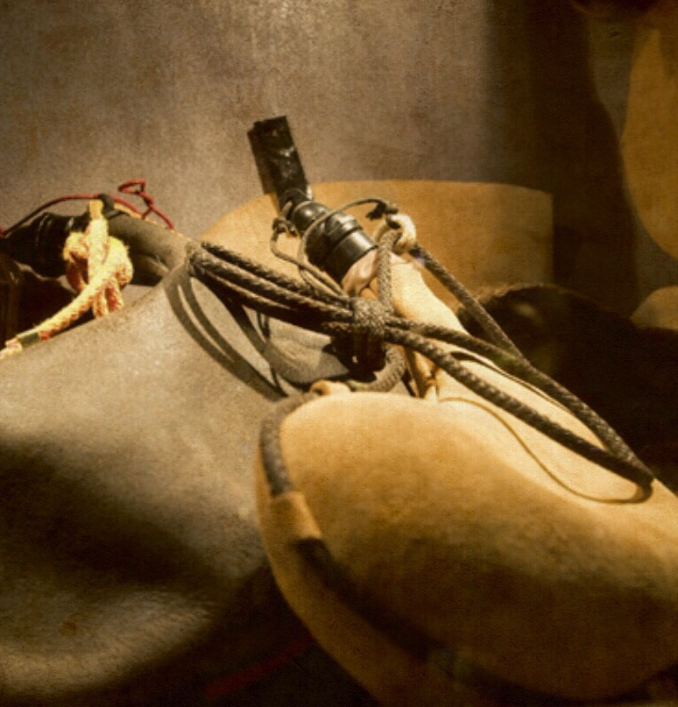
Scripture Inspiration
“People do not put new wine into old wineskins. Otherwise the skins burst, the wine spills out, and the skins are ruined. Rather, they pour new wine into fresh wineskins, and both are preserved.”
Matthew 9:17

Slide 29
Thinking Adaptively
The vision and practices in the Directory for Catechesis and the new context (challenges) for catechesis today call for adaptive responses – new ways of thinking and acting – that envision new catechetical models and approaches. Technical solutions in catechesis– using existing practices and approaches – are not well suited to the new context of catechesis today. Adaptive responses are flexible and dynamic responses to changing circumstances, involving the ability to learn, innovate, and adjust behaviors or strategies to effectively address new challenges or situations.
Technical Fixes
Adaptive Strategies

Slide 30
Thinking Adaptively
How do we get people back to Mass on Sunday?
How can we keep our teens involved in church after Confirmation?
How do reach young adults who have left our churches?
How do we make sure our families are practicing their faith at home and bringing their children to church and classes?
Technical Fixes
Adaptive Strategies

Slide 31
Some of the Adaptive Challenges We Face
Diversity in the religious & spiritual lives of people
Declining levels of Catholic participation
Religious socialization
Ten-decade, six-generation society
Generational connection
Contemporary family life
Cultural diversity
Spiritual and religious life of Generation Z
Faith unbundled among young people
Mental health
Digital culture

Slide 32
Catechesis in a Changing Context
Catechesis in a Stable Environment
Continuity
A Changing Context
Social, Cultural, Economic, Demographic
Liminality
Catechesis in a New Context
Emergence

Slide 33
Design Work
We will be designing new catechetical initiatives for 6 audiences.
Select an audience you want to design for and join the table group.
Intergenerational (All Ages Together)
Families
Children
Adolescents
Young Adults (20s-30s)
Adults (40+):Midlife Adults (40s-50s), Mature Adults (60s-70s), Older Adults (80+)

Slide 34
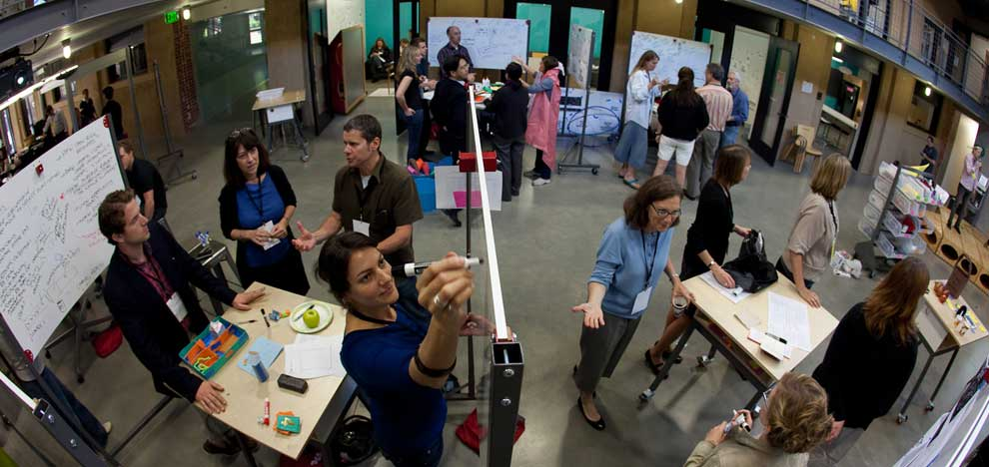
Innovation Design Process
Stanford School of Design
Empathize
Define
Ideate
Test
Prototype

Slide 35
Designing Catechesis
Target Audience:
Empathize with your target audience
Define the Design Challenge
(from the perspective of the target audience)
Connect to the Directory for Catechesis
Generate Ideas & Strategies
Create Prototypes
Test the Prototypes

Slide 36
Designing Catechesis
1. Empathize
How would you describe the life situations of your target audience?
What are the life tasks specific to their stage of life?
What are the religious and spiritual characteristics of your target audience?

Slide 37
Your Target Audience
What are they saying: about their lives, faith, spirituality, etc.?
What are they doing or how are they living: their actions and behaviors?
What are they thinking: their convictions, beliefs?
What are they feeling?
Identify the needs that surfaced.
Identify insights that emerged.

Slide 38
Designing Catechesis
2. Define the Challenge – from the perspective of the target audience
What is the design challenge you want to address in developing catechesis with your target audience?

Slide 39
Design Challenges
How can we address the diversity of people’s faith and religious/spiritual practice today (parents, teens, adults)?
  Vibrant faith and active engagement
  Occasional engagement and faith is less central to life
  Spiritual, but not engaged with a faith community
  Unaffiliated, uninvolved, religion not important
How can we equip parents to become faith formers of their young children from Baptism to 5 years old?
How can we involve younger generations in learning experiences that engage them (head, hearts, hands) and are designed around how they learn best today?
How can we engage adults in faith forming experiences that address their complex lives, busy schedules, and their diverse religious and spiritual needs?

Slide 40
Designing Catechesis
3. Connect to the Directory for Catechesis
What can you draw upon in the Directory to address your design challenge, especially the vision and practices described in the Directory for your target audience?
  See Part 3 in the Manual for the Directory’s vision.
  Review the ideas & strategies for your target audience in the Manual.

Slide 41
Using the Directory in Designing
Use 12 principles & practices to guide the design of catechesis with families and all ages.
Use the summary & strategies in the Program Manual to design catechesis for a particular target audience.

Slide 42
12 Principles & Practices for Catechesis
Living Encounter with Jesus Christ
Holistic Formation:
5 Tasks
Catechumenal Process
Inter-generational
Family and Home
Lifelong and Lifewide
Responsive to Diverse Religious Lives
Engaging Cultures
Valuing Human Experience
Intrinsic Motivation for Growth
Effective Learning Practices
Digital Tools and Approaches

Slide 43
Using the Directory in Designing
Kerygma – at the center of all catechetical programs/activities
Five Tasks – holistic catechesis at each stage of life
Catechumenal model – tailoring catechesis around faith journeys at each age, for sacramental prep
Family catechesis
Digital catechesis & catechesis in the digital “world”

Slide 44
Designing Catechesis
4. Generate Ideas
What would it be like if we. . .
Generate ideas and strategies that address the design challenge – no discussion, no critique
Assume you have the resources you need ($, people, facility, etc.)
Don’t place limits on your creativity

Slide 45
Designing Catechesis
5. Prototypes
What strategies can you use to create new initiatives that address your design challenge?
How can you transform your ideas and strategies into projects/initiatives that your target audience can experience?

Slide 46
Small Scale Prototyping
Prototyping is getting ideas and explorations out of your head and into the physical world.
In early explorations keep your prototypes rough and rapid to allow yourself to learn quickly and investigate a lot of different possibilities.
Identify a group within the target audience for piloting or a limited launch of a project in order to test the project
Implement the project and get regular feedback on its implementation and effectiveness
Develop leaders through the piloting phase so that they can be involved in the wider launch of the project

Slide 47
Challenge: Engaging Today’s Learners
(see page 33-35)
Design Challenge: How to involve younger generations in learning experiences that engage them (head, hearts, hands) and are designed around how they learn best today.
Prototype: Design courses and programs incorporating new methods of learning.
Personalized learning
Differentiated instruction
Active learning
Practice-oriented learning
Collaborative learning
Project-based learning
Multiple intelligences learning
Multi-sensory learning
Microlearning
Dual coding: visual & verbal
Digital methods
Evaluate & redesign children and adolescent catechetical programs
Introduce new methods throughout the year
Prepare catechists and leaders

Slide 48
Challenge: Complexity & Diversity
(see page 59 & 69-70)
Design Response
How to engage people in faith forming experiences that address their complex lives, busy schedules, and their diverse religious and spiritual needs?
Prototype: A Menu of Faith Forming Experiences
Tailored to people’s religious needs
Incorporating all five elements (tasks): knowledge, liturgy, moral formation, prayer & spiritual formation, active engagement in life and mission of the faith community
Variety of offerings and programming
  Content, programs, activities
  Formats—on your own, mentored, small groups, and large groups
  Times to participate and scheduling options (synchronous and asynchronous)
  Hybrid, online, and gathered

Slide 49
Challenge: Participation & Learning in Confirmation Preparation
(see page 41-41)
Design Challenge:
How to engage young people in a high quality formation experience through a Confirmation preparation program.
Prototype: Hybrid Confirmation preparation that includes a monthly theme with:
Online learning experiences on the theme (on your own, at your pace)
Small group meeting with adult guide to discuss and apply learning
Large group gathering with interactive experiences, short presentations, ideas for living faith, prayer and liturgy
Plus an annual retreat + service projects

Slide 50
Challenge: Guiding Parents in Forming the Faith of Young Children
(see page 46-49)
Design Response: How can we equip parents to become faith formers of their young children from Baptism to 5 years old.
Prototype: A catechumenal model of formation for Baptism through 5 years old
Personalize sacrament preparation to address their religious life and needs of parents
Celebrate the sacrament
Provide mystagogy by accompanying parents with support and resources for faith forming

Slide 51
Baptism & Families with Children 0-5
Preparation
Catechesis tailored to the faith life and journey of the parents – offered in multiple formats
Celebration
Celebration of Baptism
Mystagogy
Curated of faith practices every 6 months
Preparation for the sacrament
@Home celebration
Welcoming the family into the parish community
Just for Parents continuing formation
Online support group
Gatherings at church for parents and children (quarterly)
Intro to the Christian life
Mentor/Guide
Seasons of the year
Raising children support

Slide 52
Challenge: Diversity of Adult Faith
(see page 67-72)
Design Challenge: How to address the diversity of adult faith and religious/spiritual practice today?
Vibrant faith and active engagement
Occasional engagement and faith is less central to life
Spiritual, but not engaged with a faith community
Unaffiliated, uninvolved, religion not important
Prototype: Different forms of adult catechesis
tailored to the adult faith profiles
Taste & See Experiences
Refresher Experiences
Growing Experiences
Go Deeper Experiences

Slide 53
Designing Catechesis
6. Test the Prototypes
How will you pilot the prototype?
How will you engage people in experiencing the prototype?
How will you obtain feedback on people’s experience of the prototype?
How will you revise/update the designs to engage more people (scale it up)?

Slide 54
+
Likes, Benefits, Helpful, Positive
△
Wishes, Improvements
?
Questions, Wonderings
💡
New Insights and Learning

Slide 55
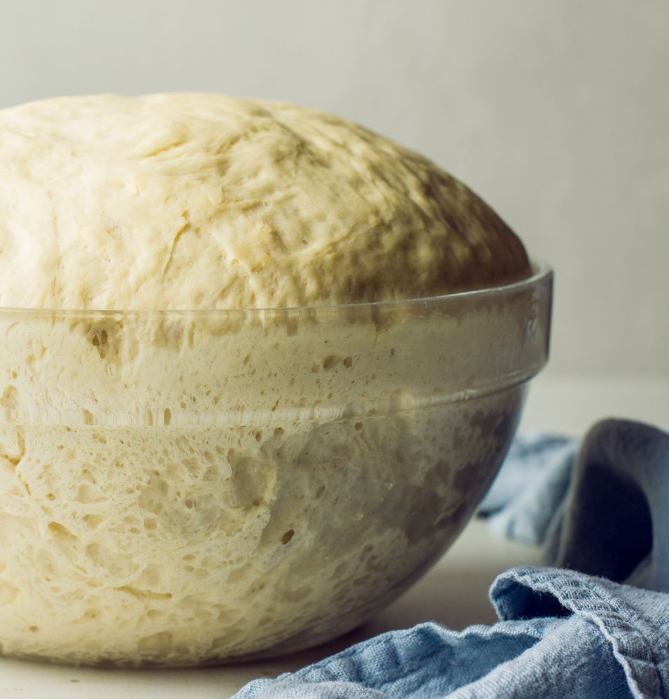
Scripture Inspiration
He spoke to them another parable. “The kingdom of heaven is like yeast that a woman took and mixed with three measures of wheat flour until the whole batch was leavened.”
Matthew 13:33

Slide 56
Part 3. Designing Catechesis for All Ages – Part 2
Group Presentations: Potential Prototypes for Your Target Audience
Applying the Process
  What did I learn about adaptive design?
  How can you use this process in catechetical ministry within your parish?

Slide 57
Part 4. Formation of Catechists
The catechist is a missionary disciple, who communicates the Gospel and accompanies and educates believers in the faith.
Identity
Witness of faith and keeper of the memory of God
Teacher and a mystagogue
Accompanier and educator

Slide 58
Part 4. Formation of Catechists
Formation
Being: formed to become a witness of faith and keeper of the memory of God; and to “knowing-how to be with” relational ability.
Knowledge: formed to a teacher who instructs in the faith and knows salvation history, the core of the Christian message, and Church teaching.
Savior-Faire: formed in pedagogical and methodological attitudes
(“Savoir faire is French for to know how to do. In English, we use it as a noun referring to the ability to do the right or appropriate thing in any situation.”)

Slide 59
Part 4. Formation of Catechists
Adult Learning Principles & Methods
Self-directed learners
Need to learn
Connected prior knowledge and experience
Life-centered and practice-centered
Set their own pace and time for learning
Supportive and conducive environment
Recognize the variety of learning styles
Engage head, heart, and hands
See progress toward their goals
Apply what they are learning
Variety of formats
On Your Own
Mentored: 1-1
Small Group
Large Group
Hybrid Approaches

Slide 60
Example: Catechist Learning Cycle
Step 2
Discern your level of proficiency in the content you need to learn.
Step 3
Experience the formation program, course, and/or resources.
Step 5
Evaluate your learning by reviewing your original discernment tool.
Step 1
Review the content in you are teaching and identify what you need to learn that would be most helpful to you.
Step 4
Create a practical project that demonstrates your learning and that you can use in your teaching.

Slide 61
Example: Catechist Learning Cycle
Identity the content in the program or the course you will be teaching.
Discover your level of proficiency with the content and in teaching the content.
Engage in learning using your learning plan and resources (in-person, online, hybrid)
  On your own
  Mentored
  Small group
  Large group
Design your practical application “project.”
Evaluate your learning.

Slide 64
Designing Catechist Formation
Empathize with your target audience:
  5-6 characteristics about the life and faith of catechists today
Define the Design Challenge
  What could catechist formation look like if it were designed for the catechist, with the Directory’s vision of the catechist and formation of catechists, and using adult learning practices.
Generate ideas & strategies to address the challenge
Create a Prototype of Catechist Formation
Test the Prototype

